Slide 1

bookend
a text classifier
Team 4
the data-dart team:
Kyle Dettman, Elaad Applebaum, Diptanil Roy, Nikhil Tilak
github.com/data-dart/bookend

Slide 2
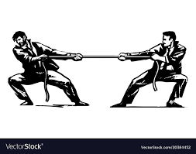

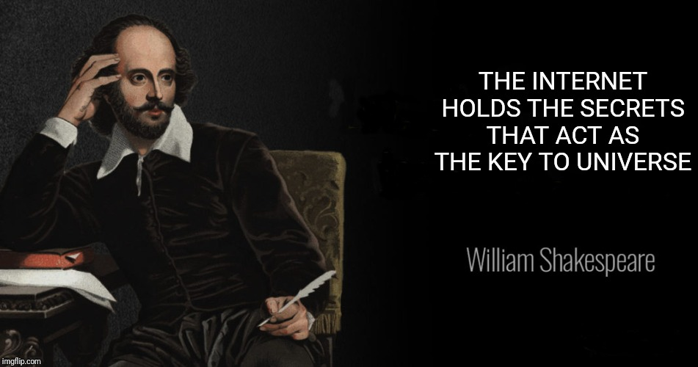
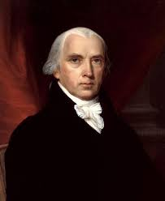

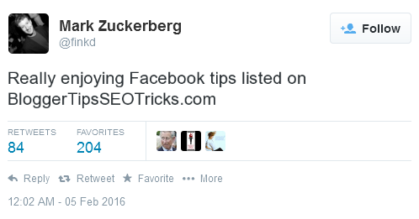
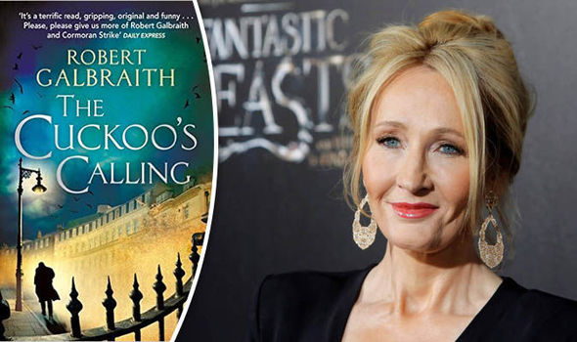
Overview
Who wrote the disputed essays of the Federalist Papers?
Was the bard ahead of his time?
Bot or not?
Who is Robert Galbraith?

Slide 3
Overview
All of these questions require authorship attribution.
Enter bookend.
We have trained an ensemble classifier on snippets of text from 12 authors, with features built from a variety of natural language processing (NLP) techniques.

Slide 4
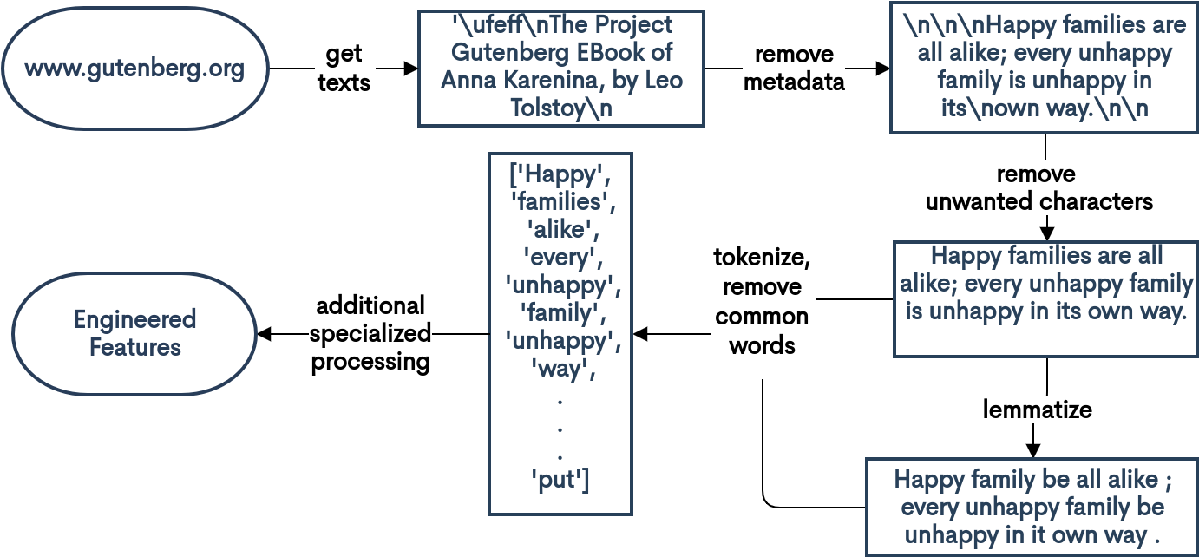
Methods: Data Acquisition and Cleaning
Data sources: www.gutenberg.org texts (automated author search and download)
Data processing:
Useful packages: nltk, textstat, ngram_graphs, sklearn, requests, bs4

Slide 5
Methods: feature engineering and model training
n-grams |  | lexical features |  | bag-of-words |  | syntactic features
 |  | ['No', 'one', 'would', 'have', 'believed', 'in', 'the', 'last', 'years', ...] | [2, 3, 5, 4, 8, 2, 3, 4, 5, ...] | ['No', 'one', 'would', 'have', 'believed', 'in', 'the', 'last', 'years', ...] | [0, 1, 1, 0, 1, 0, 0, 1, 0, 0, 1, …] | ['No', 'one', 'would', 'have', 'believed', 'in', 'the', 'last', 'years', ...] | ['DET', 'NOUN', 'VERB', 'VERB', 'VERB', 'CONJ', 'DET', 'ADJ', 'NOUN', …]
Kyle |  | Elaad |  | Nikhil |  | Diptanil
No one would have believed
No one
one would
would have
have believed
SVC
logit
SVC
soft-voting ensemble classifier

Slide 6
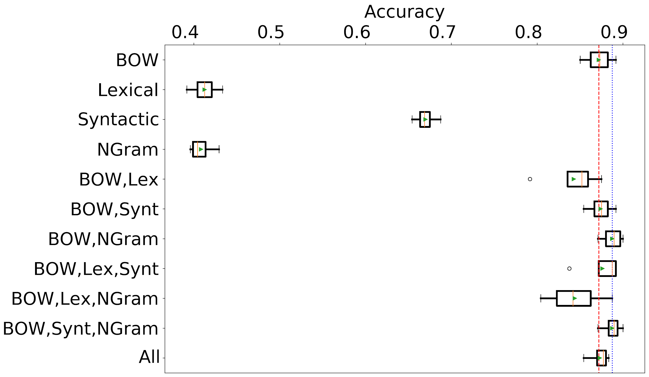
Model Selection
single-feature models
ensemble models
SVC
logit
SVC
soft-voting ensemble classifier

Slide 7
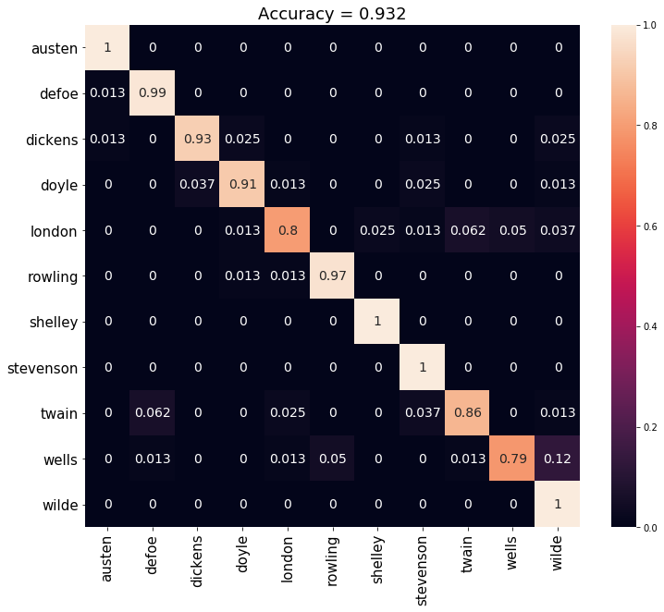
Results
~90% accuracy on new samples from unseen books
True Author
*Carroll has been removed here, as we spuriously included his math textbooks, not just his writings
Predicted Author

Slide 8
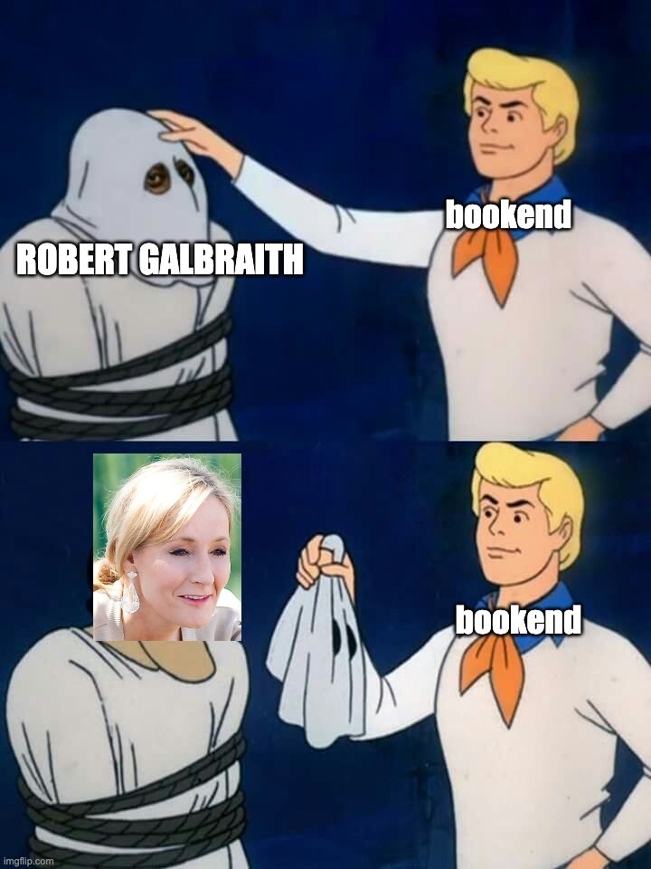


Specific Examples
Who wrote the Cormoran Strike series?
12 essays in The Federalist Papers have disputed authorship. Who wrote them?

Slide 9
Next Steps
Extend model to shorter snippet lengths
Build an interactive web/phone app
Future applications:
Twitter bot identifier
Plagiarism detector
Authorship attribution

Slide 10
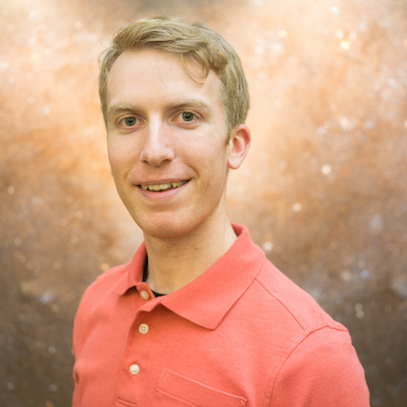
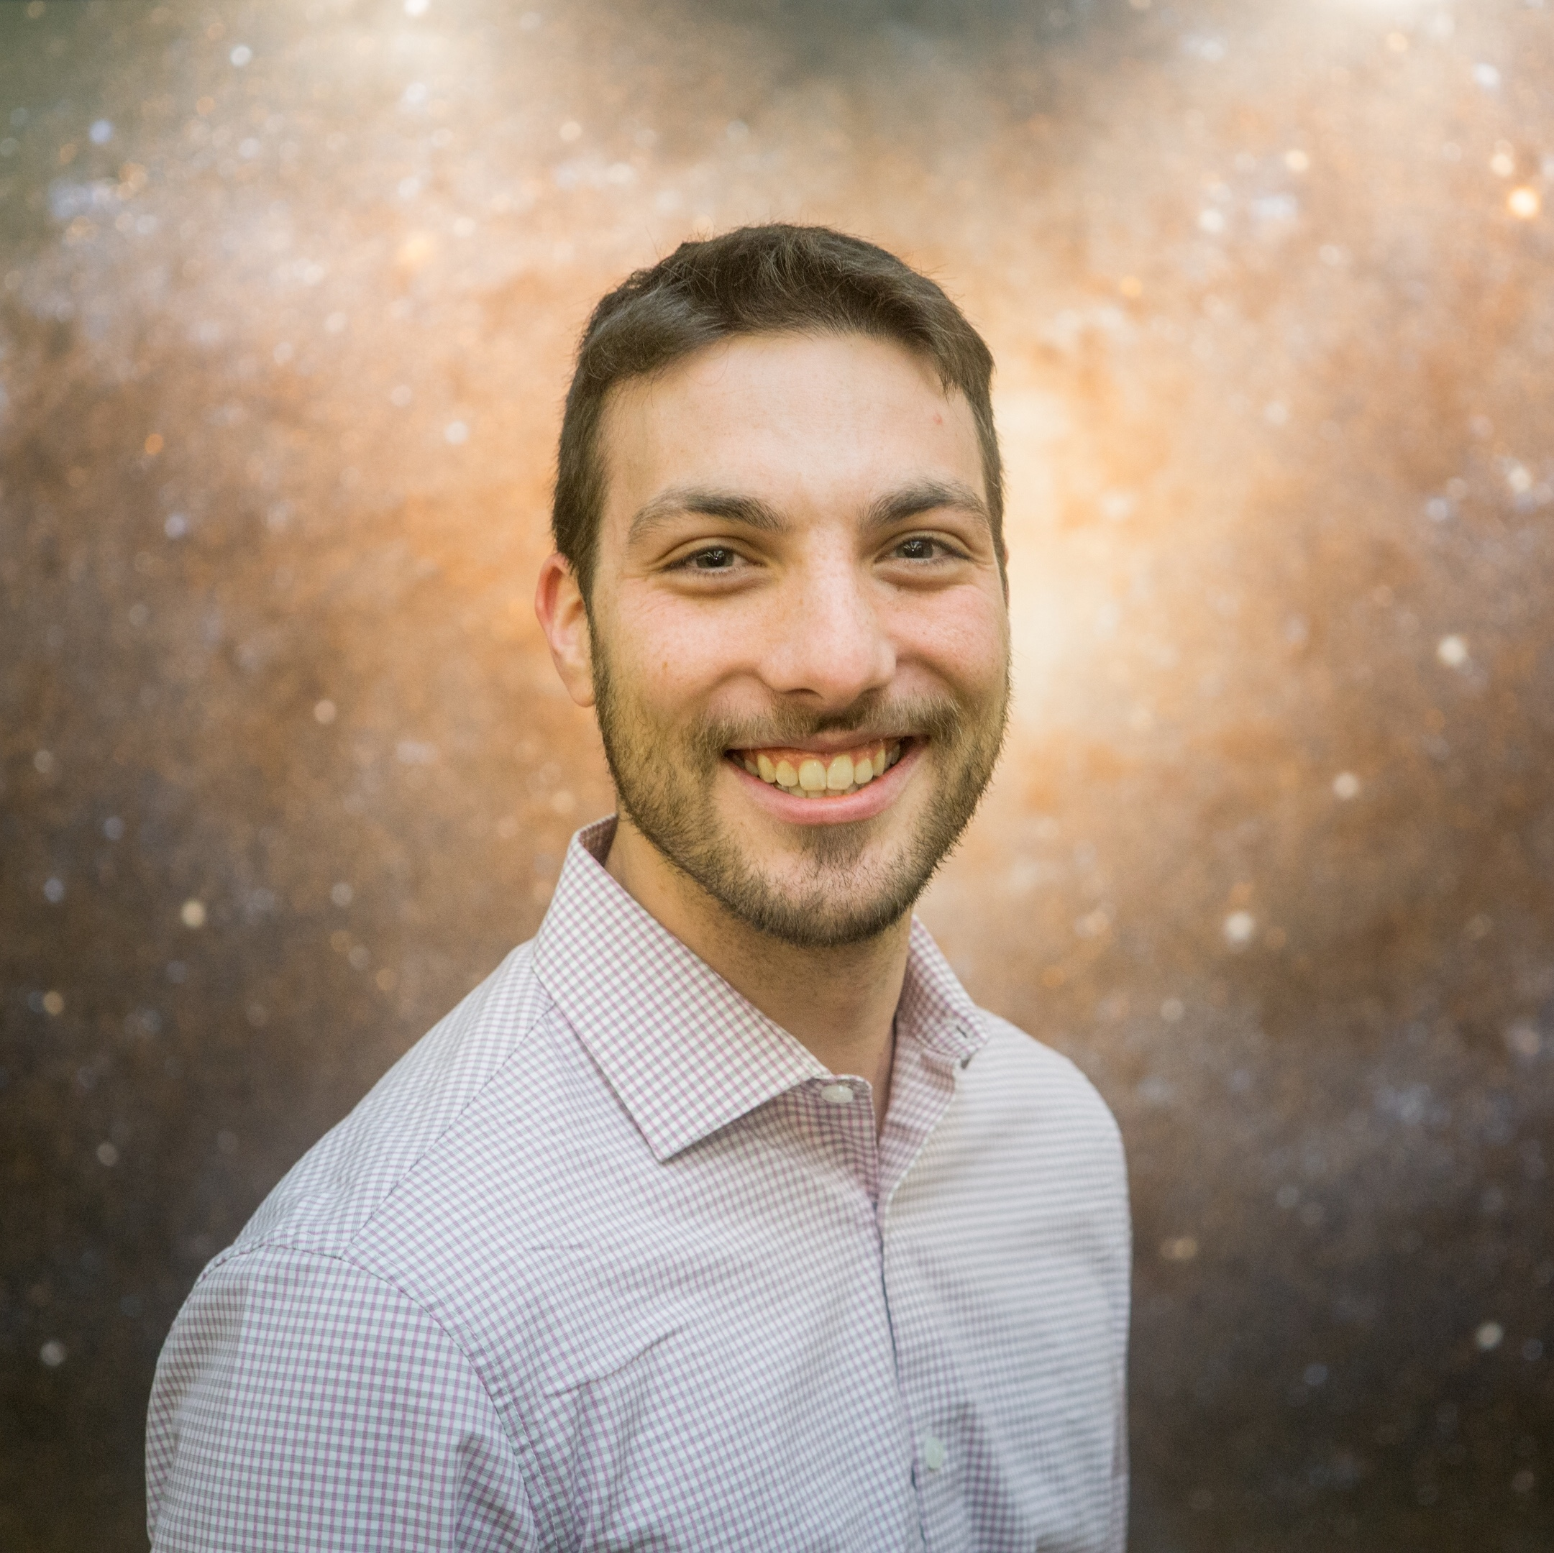
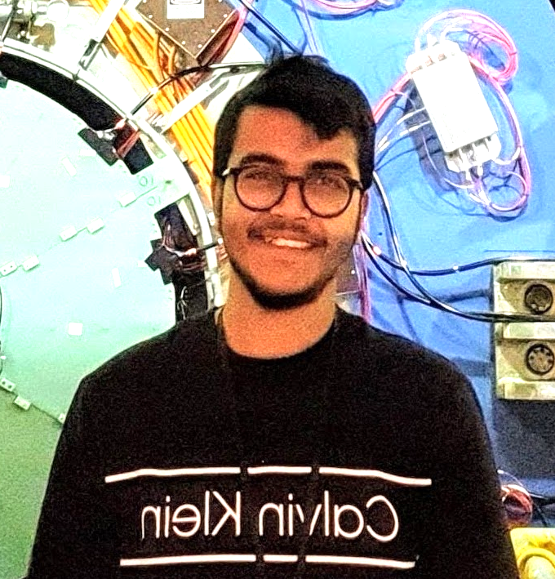
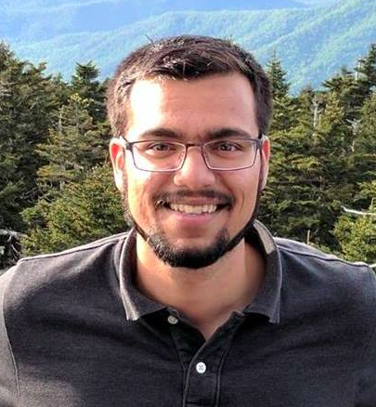

>>> pipe.predict('Thank You!')
github.com/data-dart/bookend
Kyle Dettman kgdettman@gmail.com | Elaad Applebaum elaad.applebaum@gmail.com | Diptanil Roy roydiptanil@gmail.com | Nikhil Tilak nikhiltilak1991@gmail.com

